Slide 1


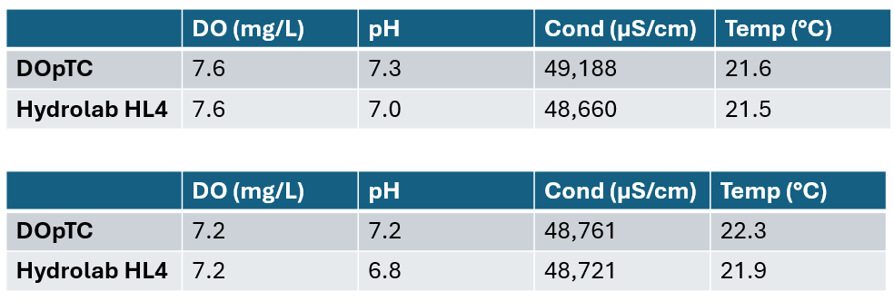
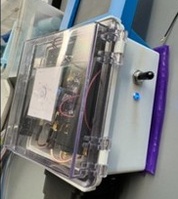
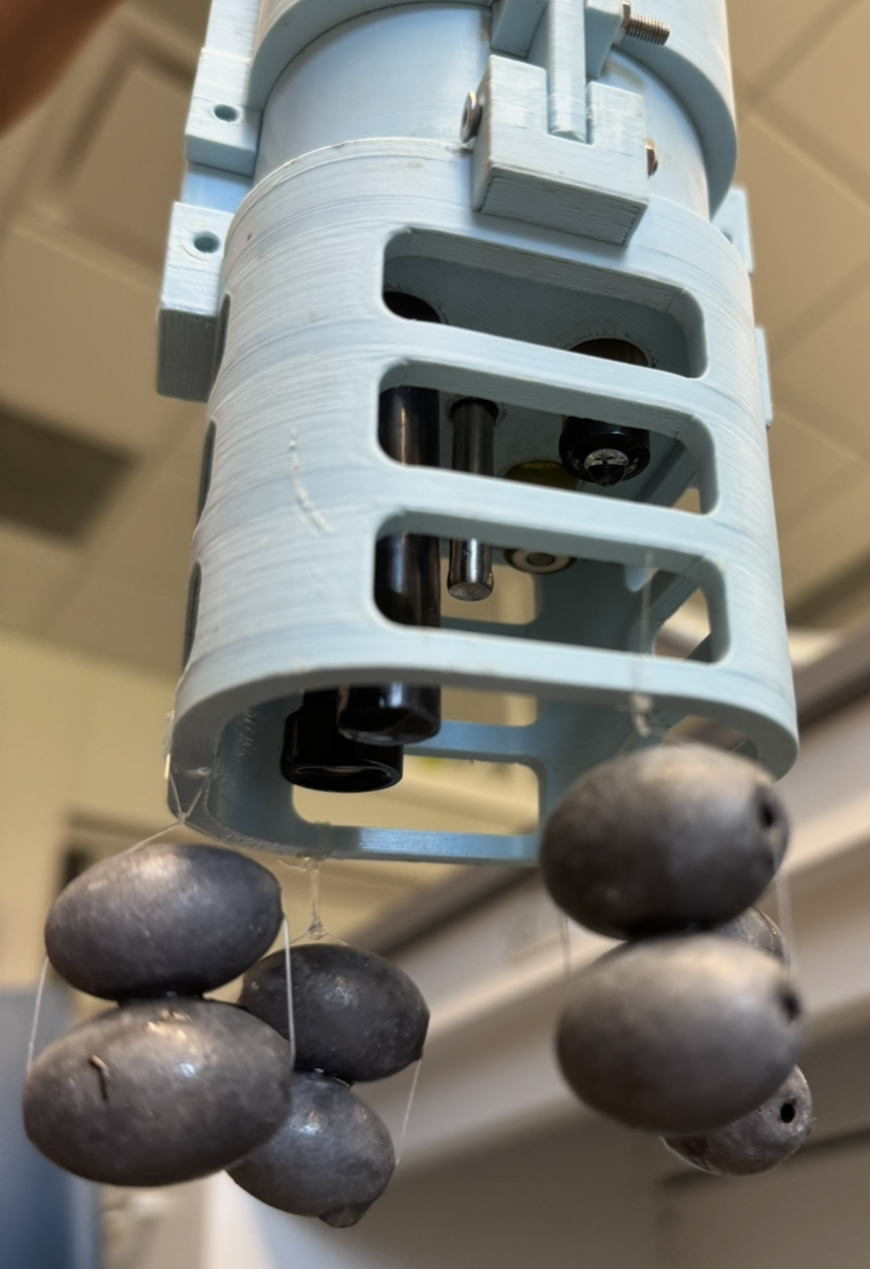
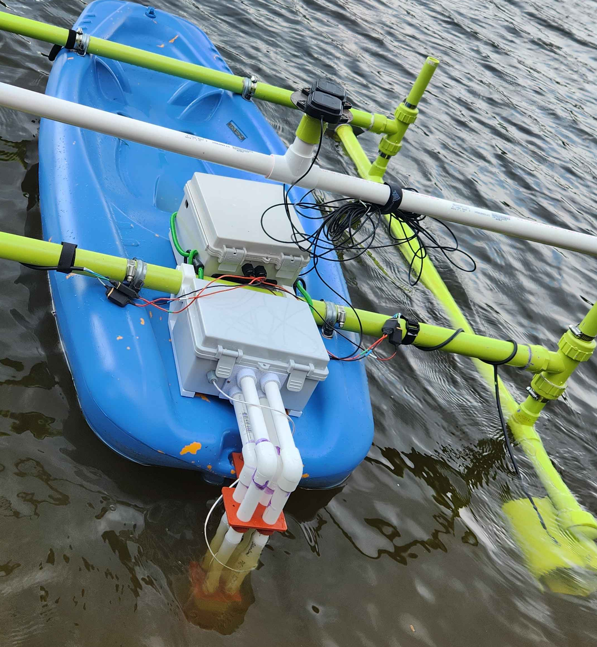
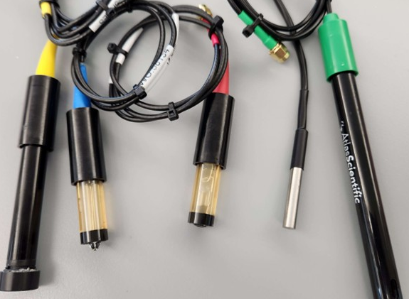
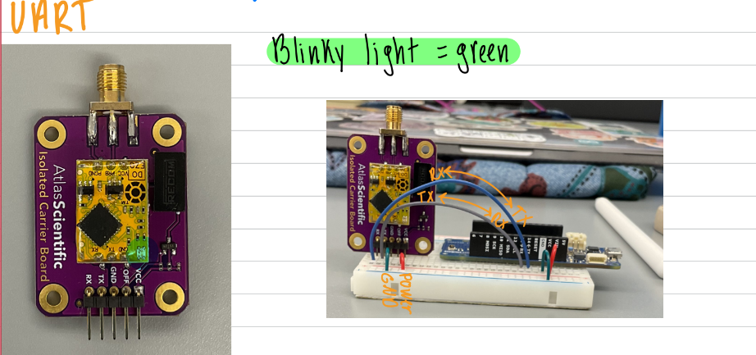
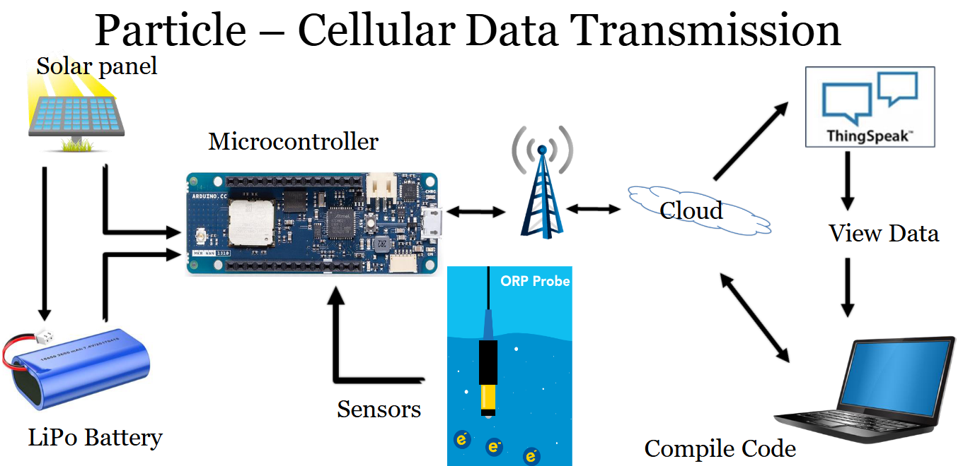
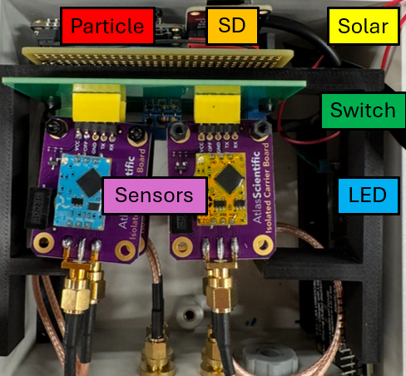
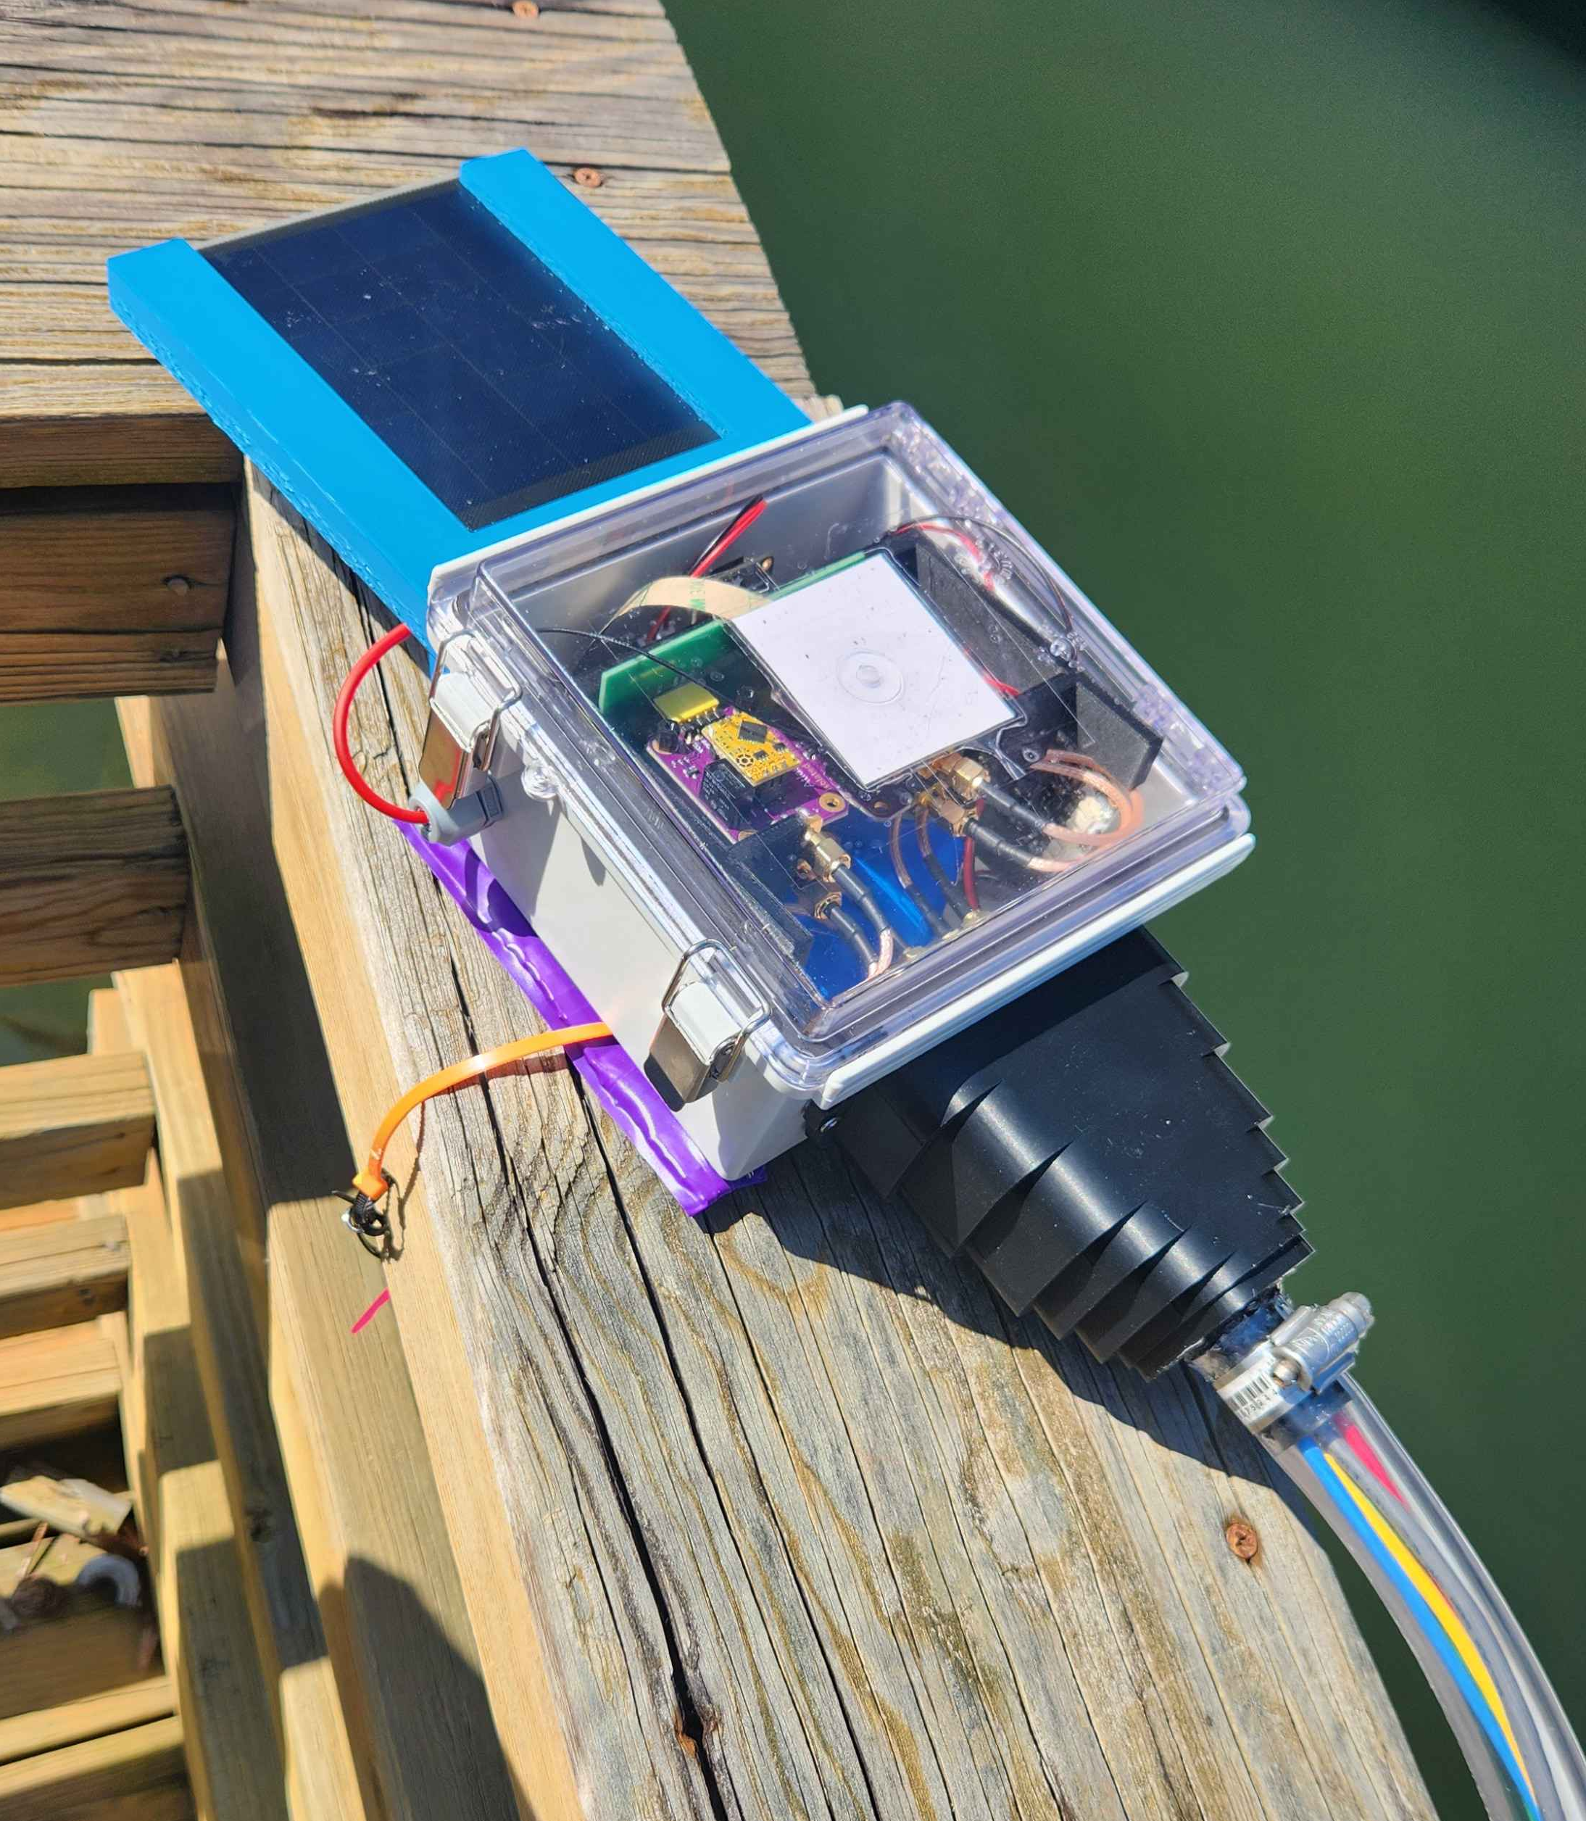
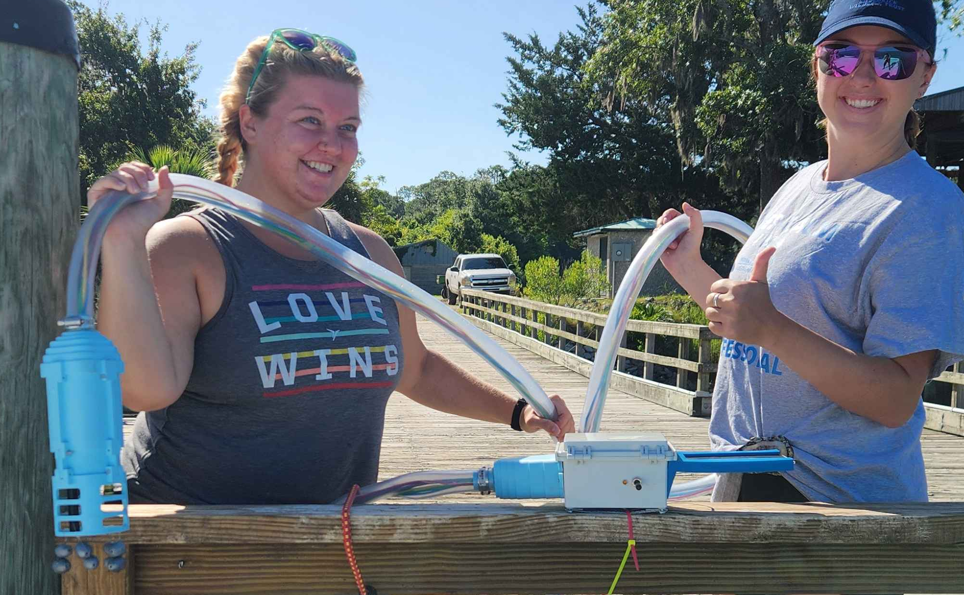

DOpTC: A Low-Cost Remote Water Quality Monitoring System
Mason Leavins, Emma Herndon, Nelson Lau, Victoria Makowski and Dr. J. A. Hauger
Department of Physics and Biophysics, Augusta University
Introduction
Methods & Materials
Results
Water quality monitoring is essential for determining the health of a water system and monitoring anthropogenic pollutants. Current commercial sensors for water quality monitoring are costly and limited in configuration options. Handheld devices typically lack data storage and are generally not useful for long-term remote monitoring. Commercial devices that do offer data storage are generally limited to storing only on the device, meaning data must be manually retrieved.
This project set out to develop a device that improves upon these limitations at a lower cost than commercial sensors. Using individual lab-grade chemical probes, a Particle brand microcontroller, and other widely available materials, a deployable device was made that can collect and transmit data remotely via cellular connectivity or long-range radio.
Other key features:
Solar panel for sustained battery life
Micro SD data backup on device
Exterior power switch and LED indicator
Weighted 3D printed probe housing
Modified IP67 box to house electronics
Time and date stamping for data points
Data is collected at set time intervals and displayed on a dashboard created in ThingSpeak
Table 1. Comparison of Values from DOpTC to a Commercial Device
Measurements taken with DOpTC are comparable to values given by current commercial products
The final cost of DOpTC is less than $1,000, with specific price depending on factors such as hose/cable length, microcontroller type, and customization of sensors
Methods & Materials
Conclusion
This research focuses on the development of an alternative device using lab-grade chemical probes from Atlas Scientific connected to a microcontroller.
DOpTC, is an acronym of the values it measures. The probes measure dissolved oxygen (DO), ORP, pH, temperature, and conductivity. A microcontroller is used to communicate with the Atlas Scientific sensors via an I2C protocol. The temperature probe is made by DigiKey and uses Dallas one-wire.
Figure 5. Modified IP-67 box with power switch
Figure 6. Probe housing with fishing weights
Figure 7. Specialized DOpTC version attached to the ASV “WIL” at Lake Olmstead in Augusta, GA
A specialized version of DOpTC was made to integrate with an autonomous surface vehicle (ASV), known as “WIL”, created by another student researcher
Data can be collected in otherwise inaccessible areas and throughout a body of water
DOpTC is a water quality monitoring system created to be customizable, repairable, and adaptable. It has successfully completed short- and long-term deployments while transmitting data to an open-source dashboard. The device cost is a fraction of even basic commercial models, with features not available in the current market.
Future work on this project includes substituting the current membrane DO probe for the optical DFRobot probe, improving the code to be more user-friendly, and exploring more effective methods of weighing down the probe housing.
Results
DOpTC has had multiple successful deployments in various locations. Deployment times ranged from hours to several weeks
It has been tested on multiple research trips with the Augusta University Biology Department to the Satilla River and Saint Catherine’s Island
Long-term data collection was performed at the Augusta Canal
Data has been successfully transmitted via cellular network and graphed in an online dashboard accessible by a QR code
The data dashboard displays a graph for each parameter measured with values over time. The dashboard and data are open source and update in real time
Battery life has not been a limiting factor so far due to the solar panel
Acknowledgments
We wish to extend our thanks to the following:
Our peers in the AU² lab for their contributions and friendship
Augusta Utilities Department for funding this research
Wes Byne and Dr. Oscar Flite for their roles in bringing this lab from an idea to reality and their years of continued support
Dean Meyer for his help in paper and presentation editing and administrative support
Wesley Cooke, the primary developer of WIL, for his assistance and for allowing DOpTC to integrate with his existing project
Patrick Rimbey, for being our local Particle expert
Dr. Jessica Reichmuth, Francis Marion University, for her role in the biology department and Satilla river projects
And finally, Dr. Andrew Hauger for his mentorship, expertise, and energetic spirit. Without him, this family we’ve formed would not have been possible. Thank you for being the coolest old man to ever save the environment.
Figure 1. Sensor probes (left to right): Conductivity, ORP, pH, Temperature, DO
Figure 2. Atlas Scientific EZO DO circuit on an isolated carrier board
Two stand-alone versions were developed. The first uses an Arduino MKR-1310 microcontroller to operate the sensors and transmit data via long-range radio (LoRa). The next uses a Particle Boron board in an equivalent manner with data transmission via a cellular network.
Figure 3. Schematic of Particle cellular communication
Figure 4. Circuit components inside the device housing
Figure 7. DOpTC on a dock at the Augusta Canal
Figure 8. Makowski (left) and Herndon (right) deploying DOpTC on a biology research trip

